Slide 1
Meaningful O&M for Students with Visual Impairments and Additional Disabilities
Stephanie Herlich, MA, TSVI, OMS
Shelby Zimmerman, MA, TSVI, COMS
California School for the Blind - October 2024

Slide 2
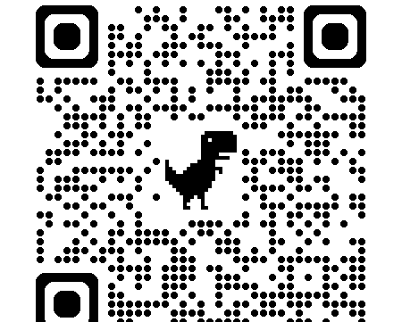
Handout
Meaningful O&M for Students with Visual Impairments and Additional Disabilities (Google Doc)

Slide 3
CSB Assessment Center Team
Stephanie Herlich, MA – Teacher of Students with Visual Impairments, Orientation and Mobility Specialist, Assessment Center Coordinator
Shelby Zimmerman, MA, COMS – Teacher of Students with Visual Impairments, Orientation and Mobility Specialist
Rebecka Henry, MS, CCC-SLP – Speech Language Pathologist
May Nguyen, MS, LEP, NCSP, ACUE – Licensed Educational Psychologist

Slide 4
Workshop Outline
Background Information
Profiles and Impact to Orientation and Mobility (O&M)
Assessment
Instruction
Case Study

Slide 5
Proprioception: What our body is doing at any point in time.
Orientation
Use of an individual’s remaining senses to determine their location in an environment
Mobility
Use of an individual’s remaining senses to determine their location in an environment

Slide 6
65% of school-age students who are visually impaired have visual and multiple impairments.
(Dote-Kwan, Chen, & Hughes, 2001; Hatton, 2001)

Slide 7
IDEA (Sec. 300.34 [c] [7]):
O&M is a related service
(ii) Including
(A) Spatial and environmental concepts
(B) Use of a long cane or a service animal
(C) use of remaining vision and distance low vision
aids
(D) Other concepts, techniques, and tools.

Slide 8
AB-947 (California Legislative Information)
SECTION 1. (a) (1): Essential for VI students to receive instruction in the expanded core curriculum (ECC).
SECTION 2. (c) Services may be provided before or after school hours.
SECTION 3. (a) (2) Evaluations shall occur in familiar and unfamiliar environments, in varying lighting conditions, and in the home, school, and community, as appropriate.

Slide 9
California Education Code 56353 & 56354
ECC “may” be beneficial and defines 9 areas of the ECC
Services provided before or after school hours
LEA includes charter schools
Services provided by certified O&M specialist
Conducted in home, school, and community and include familiar and unfamiliar environments
LEA must provide transportation if a specialist is prohibited from using a personal vehicle

Slide 10
Who Qualifies for O&M
“When it is established that their visual impairment interferes with their ability to develop environmental, spatial, or body concepts and to travel safely, efficiently, and independently in the home, school, or community environment.”
Foundations of Orientation and Mobility, Volume 1
Wiener, Welsh, & Blasch, 2010

Slide 11
Profiles & Impact to O&M

Slide 12
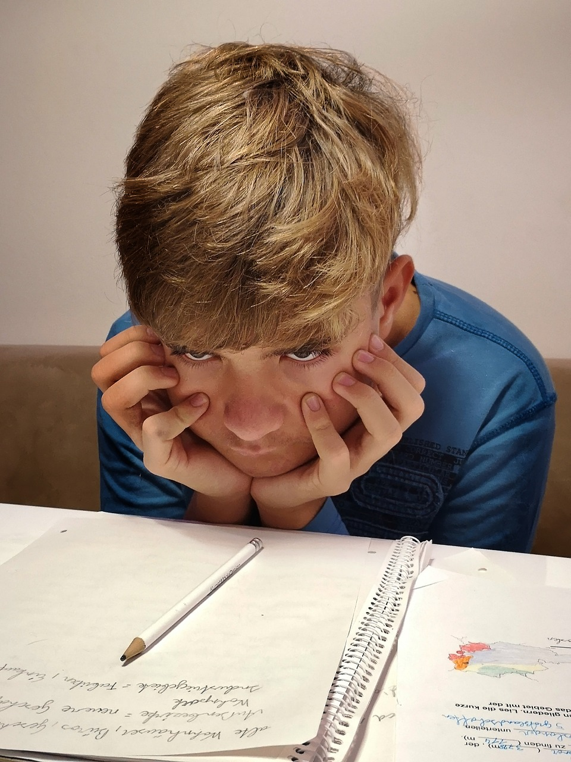
Characteristics of Learning Disabilities
Distinguishing and localizing sounds
Behavior deficits
Basic concept difficulties
Easily disoriented
Problem-solving difficulties
Memory deficits
Weak expressive & receptive language skills
Low frustration level
Easily distracted
Disorganized
Reading difficulties

Slide 13
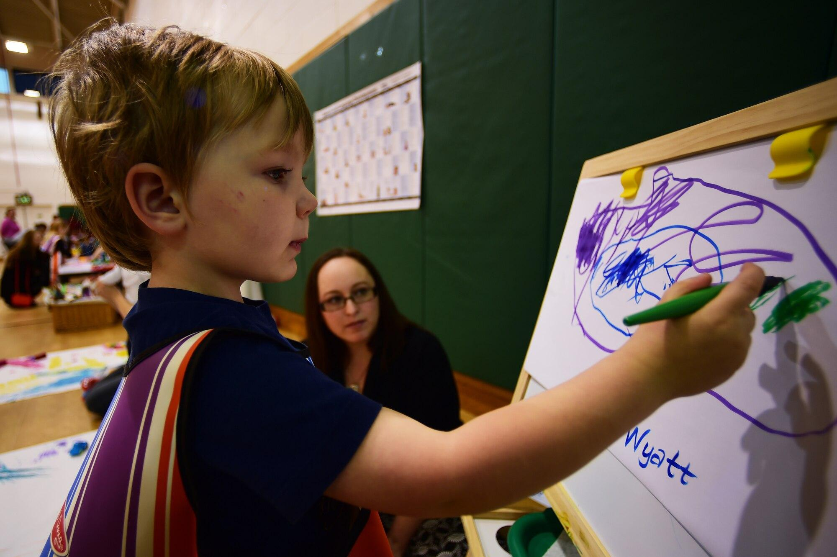
Characteristics of Intellectual Disability
Concept development
Limited attention span
Memory deficits
Inability to use abstract thinking
Inability to generalize skills across environments
Communication deficits
Poor balance, posture, flexibility, and eye-hand and eye-foot coordination
Difficulty with basic self-care needs
Social deficits

Slide 14
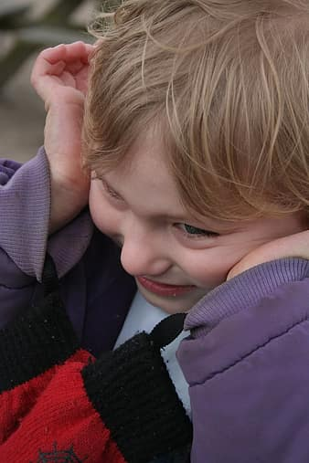
Characteristics of Autism Spectrum Disorders
Sensory sensitivity
Lack of impulse control
Difficulty with transitions
Social deficits

Slide 15
Characteristics of Cortical Visual Impairment
Color preference
Need for movement
Visual latency
Visual field preferences
Difficulties with visual complexity
  Array
  Target/object
  Multisensory
  Human faces
Need for light
Difficulty with distance viewing
Atypical visual reflexes
Difficulty with visual novelty
Difficulty with visually guided reach

Slide 16
Characteristics of Traumatic Brain Injury
(Ambrose-Zaken, Calhoon, & Keim, 2010, p. 631)
LEFT BRAIN (right side)
Logic
Words
Parts & specifics
Analysis
Sequential thinking
RIGHT BRAIN (left side)
Emotions
Pictures
Parts & whole
Synthesis (putting together)
Simultaneous & holistic thinking

Slide 17
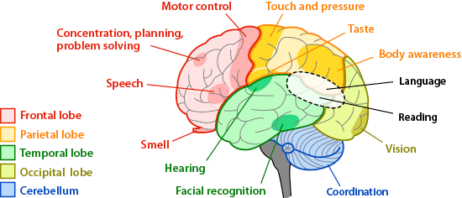
Regions of the Brain and What They Do (Arizona State University)

Slide 18
Regions of the brain and their function
Frontal Lobe – motor control, planning, concentration and problem solving, speech, and smell
Parietal Lobe – touch and pressure, tase, body awareness
Occipital Lobe – vision
Cerebellum – coordination
Reading uses 3 regions – temporal, occipital, and parietal

Slide 19
Assessment Process
Review of medical records
Interviews
Observation, observation, observation
Test
RIOT

Slide 20

Review of Records
Medical history
Current medications
Limitations
Review of previous assessments
Review of education services

Slide 21
Interviews
What motivates your child?
What are preferred activities?
What does your child do well?
What would you like to see your child do?
What else would you like me to know about your child?

Slide 22

Observation, observation, observation
(Pogrund, R. L. & Griffin-Shirley, N., 2018, p. 235)
Integration of reflexes
Orienting response
Anticipation
Habituation
Muscle tone and motor planning
Biobehavioral state
Response to sensory information
Sensory preferences

Slide 23
What's in Your Assessment Toolbox (Google Doc)
"The most important thing when giving an assessment is to know if the student understands what is being asked of them. If the student does not understand the directions, then the outcome has no meaning."
Accessible Tests Resource Center (APH)

Slide 24
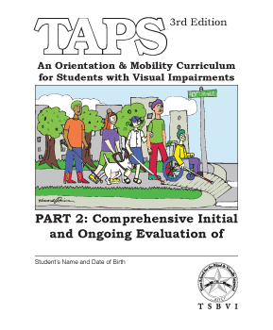

Comprehensive O&M Assessments
Teaching Age-Appropriate Purposeful Skills (TAPS), 3rd edition Assessment and Ongoing Evaluation (TSBVI)
For students ages 3 to 21
Interview questions for the student, parent/
guardian, and educators
Assessment areas and environments: home/living,
campus, residential, commercial and public
transportation, ambulatory devices
Digital supplements (TSBVI)

Slide 25
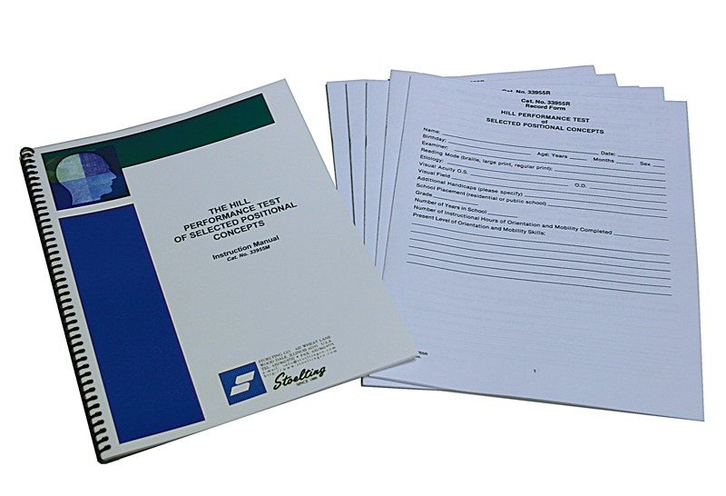
O&M - Concept Development
Hill Performance Test of Selected Positional Concepts (Stoelting)
Spatial/positional concepts (ex. front, back, left, right)
  Relationships of body parts
  Moving body parts in relation to one another
  Moving the body in relationship to objects
  Object-to-object relationship

Slide 26

O&M - Early Learners
Texas 2 STEPS Curriculum and Evaluation Set (TSBVI) - ages 0-5
Inventory of Purposeful Movement Behaviors (PDF) - (Anthony, 2004) ages 0-6
O&M Assessment: Early Years of Birth through Three (PDF) (Anthony, 2004)

Slide 27
More O&M Early Learners
Mobility and Independence: Assessment and Evaluation Scheme: Early Skills (RNIB)
INSITE Developmental Checklist: Assessment of Developmental Skills for Young Multidisabled Sensory Impaired (MSI) Children (HOPE, Inc)
Oregon Project (Southern Oregon Education Service District)

Slide 28
O&M – Cortical Visual Impairment (CVI)
CVI Screening Tools (TeachCVI)
CVI Parent/Caregiver Interview (Christine Roman-Lantzy)
CVI Range Templates (Christine Roman-Lantzy)
CVI Progress Chart (Christine Roman-Lantzy)
CViConnect Pro
CVI Protocol (Perkins)

Slide 29
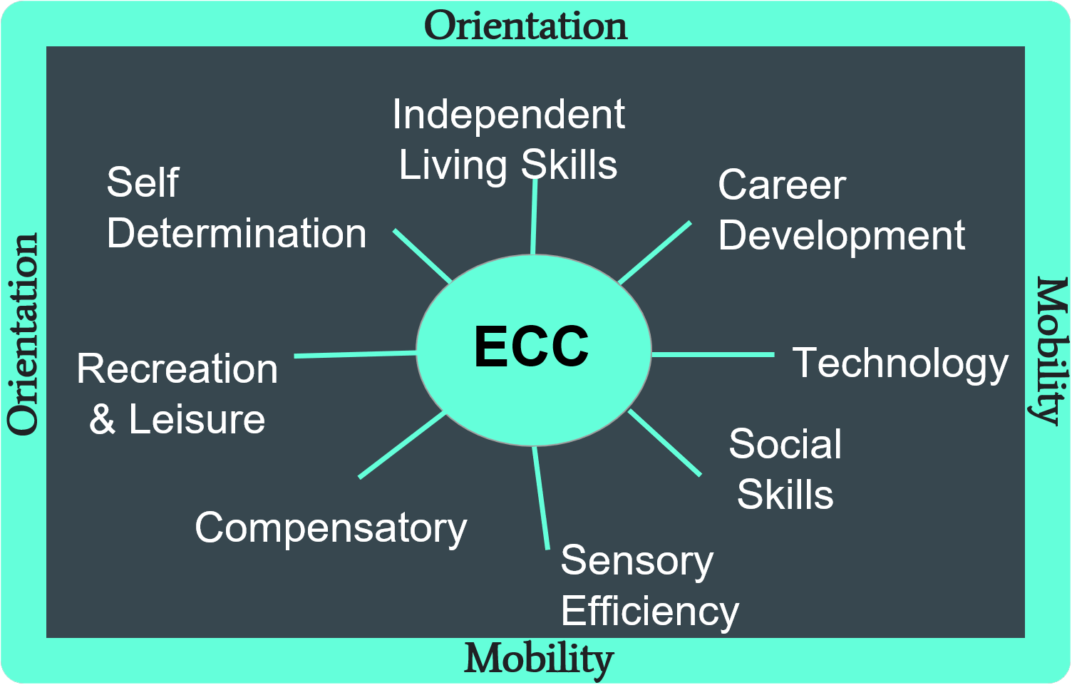
O&M and the ECC

Slide 30
Expanded Core Curriculum
Orientation and Mobility
  Independent Living Skills
  Career Development
  Technology
  Social Skills
  Sensory Efficiency
  Compensatory
  Recreation and Leisure
  Self Determination

Slide 31
Concept Development
Positional concepts: top/bottom, up/down, in/out, inside/outside, near, in front, across, short/long, high/low, around
Time concepts: first, then, next, before
Quantity: another, more, full vs empty, small vs large, missing, all, both
Qualitative: same/different, good/bad

Slide 32
Mobility Quote
“Movement is life. It is in all we do on a daily basis…for children, movement is also the natural learning medium. It is the means by which they explore the environment, learn how it functions, and interact with it.”
(Rosen, 1997, p. 170).

Slide 33
Mobility
Campus routes and level of supervision
Establish a safety word
Functional skills
Community exposure
Thematic units
*Dignity of Risk*

Slide 34
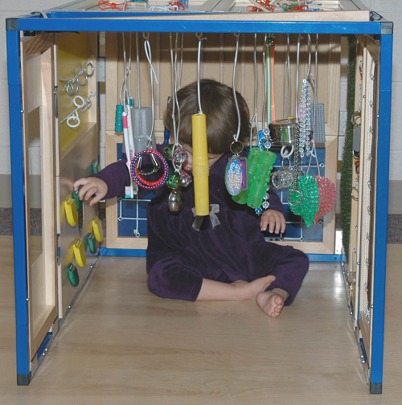
Active Learning
“Learning takes place through movement” (Nielsen, L., 1992)
Equipment from Active Learning Space (ALS)
  The Little Room (ALS)
  SPG (Scratch, Position, and Grab) Board (ALS)
  The Tipping Board (ALS)
  Aprons, vests, scarves, and belts (ALS)
  Resonance Board (ALS)

Slide 35
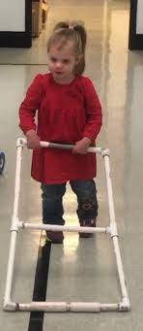
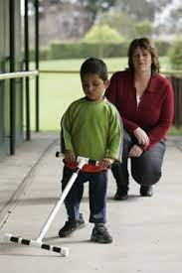
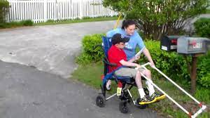
Adaptive Mobility Devices (AMDs)
Bridge the gap between basic skills and traditional cane travel
Promotes concept development, problem-solving, and self-confidence
Safer travel, optimal gait pattern, and good posture

Slide 36
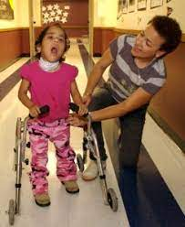
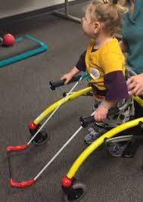
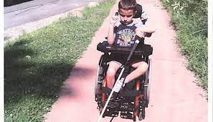
Ambulatory Aids (Wheelchairs, scooters, walkers, crutches, orthopedic canes)
Foundations of Orientation and Mobility, Volume II: Instructional Strategies and Practical Applications (APH)

Slide 37
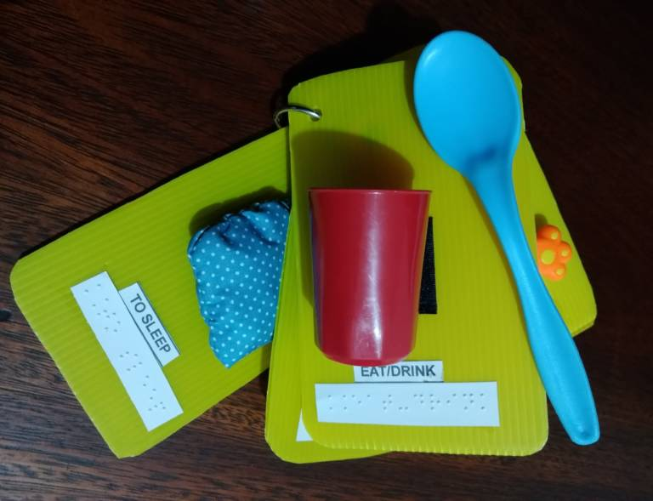
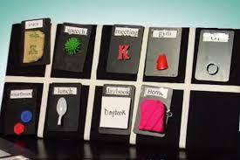
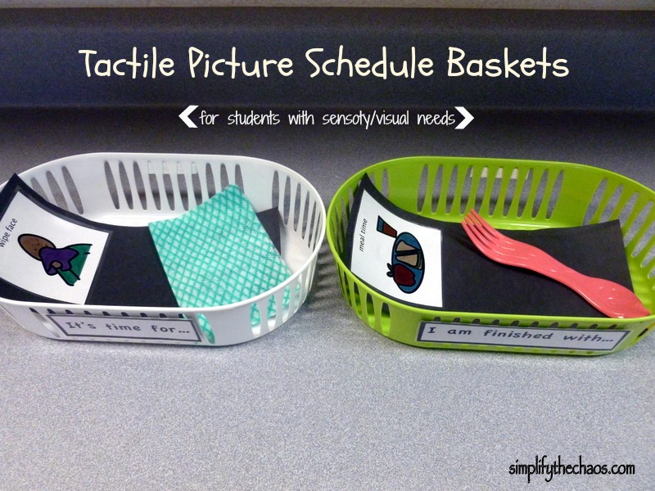
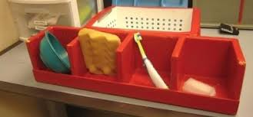
Calendars & Routines
Symbols and Meaning (SAM) Kit (APH)
Tactile Connections Kit: Symbols for Communication (APH)
All-In-One Board (APH)
Reference objects for students with multiple disabilities and visual impairements (Paths to Literacy)

Slide 38

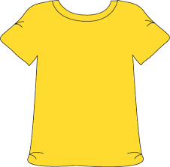
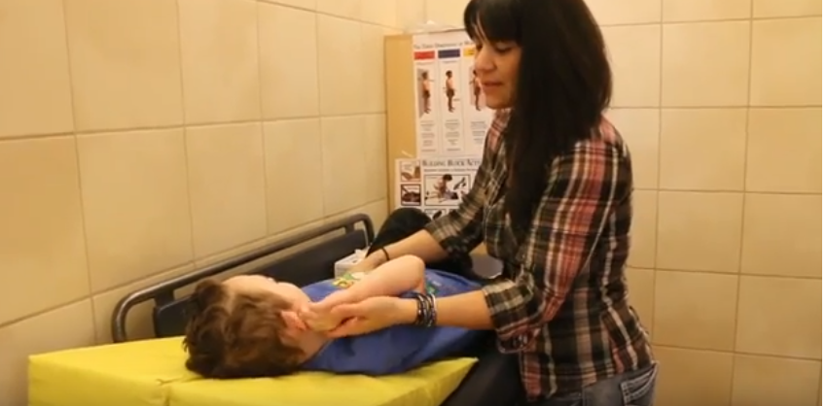
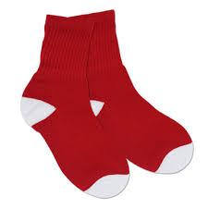



Brain Gym (YouTube) – Movement Based Learning

Slide 39
Technology
Experience books -Create books of O&M lessons and experiences.
  Pictello
  My Story

Slide 40



Instructional Tips
Use preferred objects
Consider the environment
Slow down
Don’t interrupt
Scaffold skills and task analysis
Flexibility
Include IEP team members

Slide 41
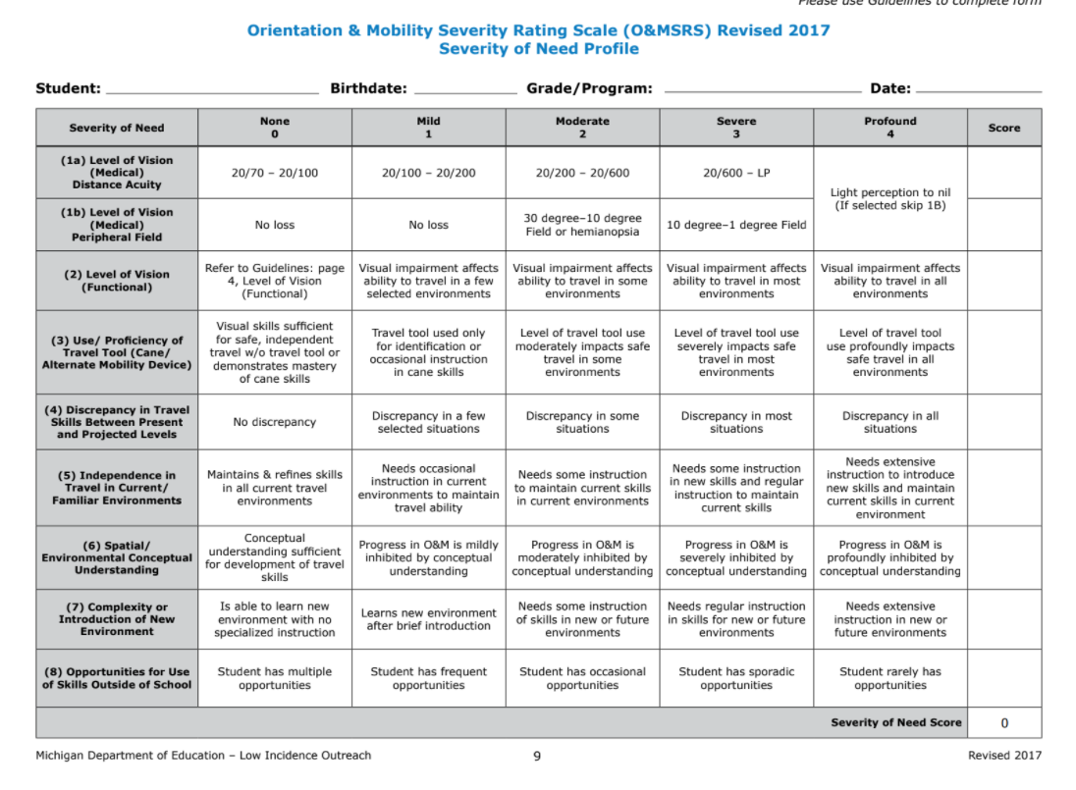
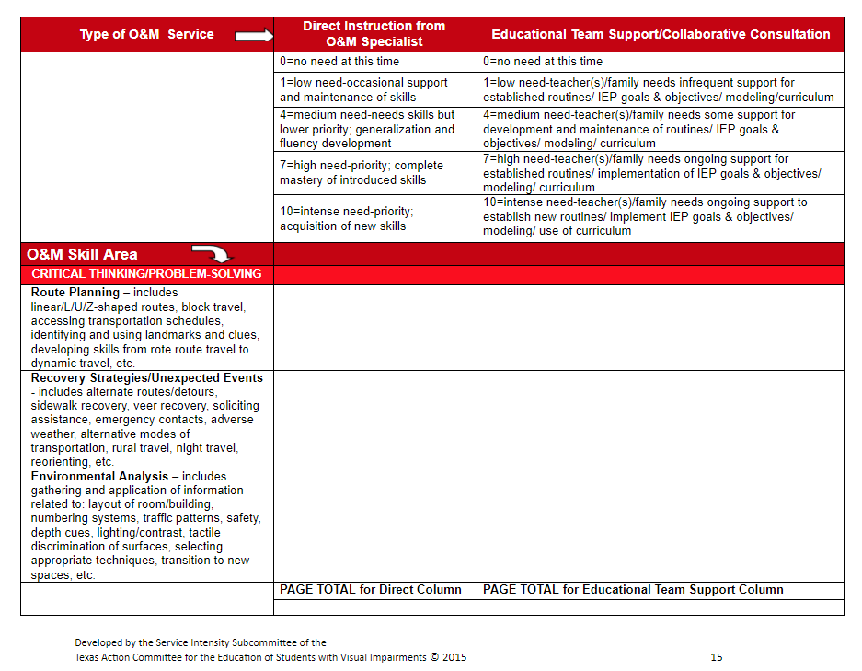
Determining Service Delivery
Michigan Severity Rating Scales
VISSIT
(TSBVI)
(MDE-LIO)

Slide 42
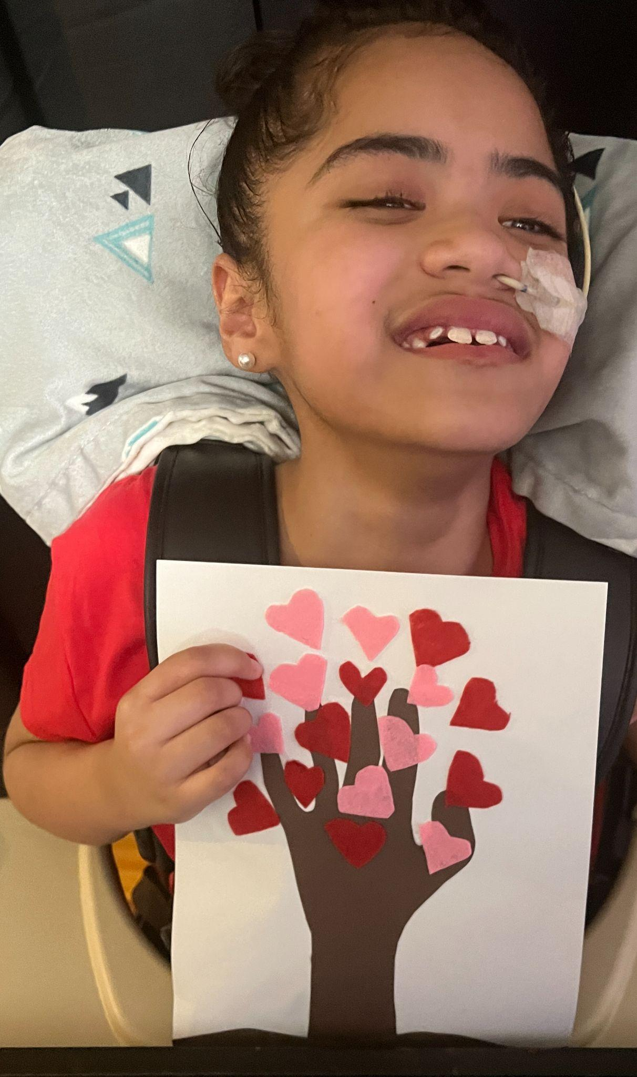
Meet Berry
8 years old
Loves balloons, bubbles, being silly, music, & her siblings.
Lives with her parent and 4 siblings.

Slide 43
Berry’s Vision & More
Cortical Visual Impairment (CVI) – phase 1
Cerebral Palsy
Absent Corpus Callosum Autosomal Deletion Syndrome
Hydrocephalus
Epilepsy (tonic/clonic, atonic, and myoclonic. High seizure activity.
Home Hospital Instruction (HHI)
Seizures
Letter sounds emerging
Rolls on a floor mat
Sits with back support
Can hold an item.

Slide 44
Interventions
IEP TEAM: Classroom teacher, SLP, AAC Specialist, OT, PT, O&M, & TVI.
Team collaboration: monthly virtual meetings, use of Google Classroom for parent to refer to or reinforce skills (works well for parent), check-in with parent to see what is working well.
Use of Berry’s preferred items and activities: siblings, balloons, and songs.

Slide 45
Berry & O&M - Beginning
Preschool:
4 years old:
Consult only
Focus on Orientation
Use of tactile cues
Parent training on descriptive language and body-to-self concepts
Minimal eye gaze, no tracking/scanning.
Short periods of focus
Minimal purposeful movement

Slide 46
What happened at 5/6 years old
Kinder/1st Grade
Direct service weekly
Used TAPS Body Movements (PDF)
Team collaboration
Sample Lesson (Google Doc)
5/6 Years Old
Increased eye gaze, latency more obvious
Longer periods of focus
Purposeful movement difficult

Slide 47
What happened at 7/8 years old
2nd Grade
Expand Body Movement Routines (Google Slides)
Lots of repetition
Spring 2023: Berry able to isolate body part and reach for it.
7/8 Years Old
Longer eye gaze
Continued Latency
Longer periods of regulation
Increased purposeful movement

Slide 48
Berry and O&M – Video #1
Berry beginning to develop purposeful movement.
Video: Berry Hearts (YouTube)
Video: Berry is sitting in her chair with her tray. Her mother is recording the video and cannot be seen. Berry is wearing a blue shirt and earrings, her dark hair pulled back, and the black chair harness. She has a G-tube in her left nostril.

Slide 49
Berry and O&M – Video #2
After one month, Berry demonstrates
more purposeful movement
Video: Berry Shamrocks (YouTube)
Video: Berry is sitting in her chair with her black chair harness. She is wearing a colorful sleeveless shirt, her dark hair is pulled back, and she has a G-tube in her left nostril. She is smiling. The shamrock is white paper cut out with green ink.

Slide 50
Testimonial from parent
“I am incredibly grateful to O&M therapy. It has been a life changer for Berry and our family. She has been able to discover so many things about her body, movement, and space.”

Slide 51

What's happening in your district/county?
Are you qualifying/not qualifying these students?
How are these students being served?
Who is providing services?
Do your administrators support qualifying these students?

Slide 52
Key Ideas
Routine
Wait Time
Charting
Repetition
Teamwork

Slide 53
Additional Resources
What's in Your Assessment Toolbox? (Google Doc)
Keys to Educational Success (APH)
Games that Enhance the O&M Experience for Children (PDRIB)
Foundations of Orientation and Mobilty, 4th Edition, Volume II (APH)
Basic Orientation and Mobility for Children with Multiple disabilities: A Starting Point (Perla & Ducret, n.d.)

