Slide 1


Addressing the Expanded Core Curriculum
August 3, 2022

Slide 2
Teacher Shortage
There is a known shortage of Teachers of Students with Visual Impairments and Certified Orientation and Mobility Specialists
American Printing House for the Blind (TVI/O&M) / U.S. Dept. of Education identified key teacher shortage area (TVI)
According to research by Dr. Cheryl Kamei Hannan at Cal. State Los Angeles there are more than 60 open positions across California. (2022)
Is there a TVI/O&M shortage in your area?
Notes:
Vacancies; on a 50% response rate; hence more than 60 vacancies but too complicated to guesstimate actual total
We need help from district administrators to be smart and savvy with bringing new people to our field

Slide 3
Teacher Grants – It’s time to Grow Your Own
SFSU and CSULA have regular grant programs; SFSU | CSULA
Program Improvement and Personnel Preparation (PIPP) of Experts Working with School-Aged Students Who are B/VI – (CSULA)
Preparing Future Educators to Use and Teach Technology – (CSULA)
AER William and Dorothy Ferrell Scholarship – (SFSU/CSULA)
CTEBVI Katie Sibert Memorial Scholarship – (SFSU/CSULA)
Golden State Teacher Grant Program – (SFSU/CSULA)
Local Educational Agency Grants – (District sought for Special Education teachers)
District Contracts

Slide 4


What is our role as TVI/O&M professionals?
AGENTS OF
A.C.C.E.S.S.
Super
Teachers
&/or
Notes:
Goal here is to elicit some conversation:
TVIs have three primary educator roles:
Adapt Materials
Support Students in coursework
Teach Special Curriculum
O&M Specialists
Teach skills related to travel in the school and community
Support other ECC instruction

Slide 5
Appreciating the amount of time needed to be an Agent of Access
We get stuck on Compensatory or functional academic skills.
The standard recommendation for an early elementary braille reader is two hours a day of services from a TVI.
Every book, worksheet, presentation, and group lesson must be adapted or reengineered to make it accessible.
How can we get unstuck and still address everything that is needed?
Notes:
Meeting the unique vision loss specific needs which as we know vary grandly based on individual students

Slide 6
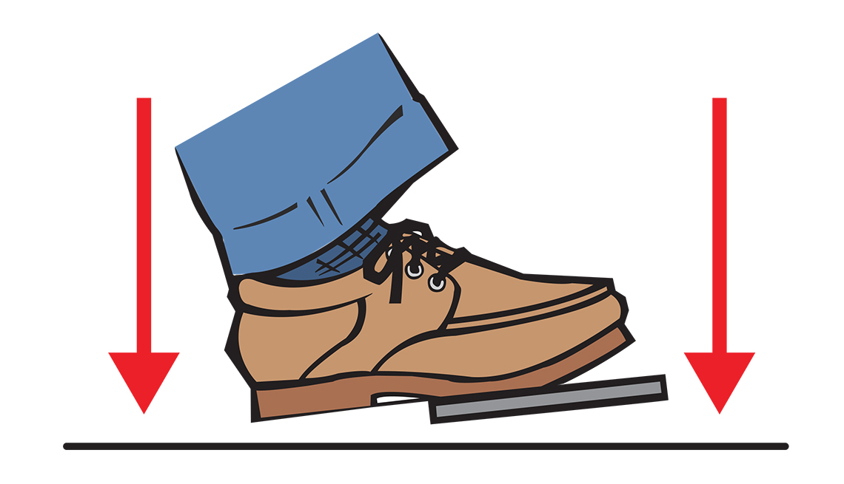
Have you done a thorough workload analysis?
Notes:
Pump Your Brakes!
Ok, I get it but maybe for another day but couldn’t not go here as it is needed to put best practices into place.
The goal is to use data to identify how a vision professionals time is spent each week, and if needed, demonstrate why additional support or personnel is needed.

Slide 7
Who exactly do we serve?
Cal. Code Regs. Tit. 5, § 3030 - Eligibility Criteria
(13) Visual impairment including blindness means an impairment in vision that, even with correction, adversely affects a child's educational performance. The term includes both partial sight and blindness.
Ideally, a current ophthalmologist or optometrist report indicates a diagnosis of eye disease, limited visual acuity after correction, visual field loss, or total blindness.
For students with low vision, a functional vision assessment aides indicates the potential benefit of special education instruction, services, materials and/or equipment which cannot be provided solely with accommodations or modifications of the regular program.
Ultimately it is an IEP team decision to verify eligibility and whether the visual impairment adversely affects the student’s educational performance and requires special education to meet the student’s needs.

Slide 8
But our caseloads really are not working. Is there any help for the student learning braille?
California Education Code ARTICLE 3.5. Individualized Education Program for Visually Impaired Pupils [56350 - 56354]
56351.5 Summarized: In accordance with an IEP, a LEA can reinforce braille instruction with an aide who is supervised by a credentialed teacher that has demonstrated grade 2 fluency and the basic rules of braille construction.
Notes:
Many districts are not utilizing or aware of the potential of an instructional assistant acting as a braille aide.

Slide 9

What is the ECC?
Share out definitions and descriptions.
Notes:
Discussion space

Slide 10
What is the ECC?
The Expanded Core Curriculum (ECC) is the body of knowledge and skills needed by students with visual impairments due to their unique disability-specific needs.

Slide 11
Wait….that sounds a lot like…
20 U.S. Code § 1401 – Definitions (29) Special education
The term “special education” means specially designed instruction, at no cost to parents, to meet the unique needs of a child with a disability, including— (A) instruction conducted in the classroom, in the home, in hospitals and institutions, and in other settings; and (B) instruction in physical education.
Notes:
The United States Code, is the codification by subject matter of the general and permanent laws of the United States. It is divided by broad subjects into 53 titles and published by the Office of the Law Revision Counsel of the U.S. House of Representatives. The U.S. Code was first published in 1926.

Slide 12
It also sounds like…
Individuals with Disabilities Education Act
“The stated purpose of the IDEA is: to ensure that all children with disabilities have available to them a free appropriate public education that emphasizes special education and related services designed to meet their unique needs and prepare them for further education, employment, and independent living”

Slide 13
Or even… the definition of an IEP
34 CFR 300.320 (a)(1)
“the term individualized education program or IEP means a written statement for each child with a disability…that must include -…functional performance…and functional goals”
§ 300.320 Definition of individualized education program
Notes:
CFR = Code of Federal Regulations

Slide 14
What more do you need?
The National Agenda for the Education of Children and Youths with Visual Impairments, Including Those with Multiple Disabilities
A Bill of Rights for All Children with Visual Impairment and their Families
Guidelines for Programs Serving Students With Visual Impairments - 2014 Revised Edition

Slide 15
Even mainstream ed. speak supports it
Local Control Funding Formula (LCFF) has distinct priorities in Conditions of Learning and being sure all students are engaged in education as well as standards of Engagement and Student Outcomes.
California’s Multi-Tiered System of Supports
It is more than just Response to Instruction and Intervention (RtI²) and Positive Behavioral Interventions and Supports (PBIS); organizing supports within an LEA to address academic and social-emotional learning.
Office of Special Education Programs (OSEP) Results Driving Accountability (RDA)
“OSEP believes it is critical that their resources be aligned to support improved educational results and functional outcomes for children with disabilities and to that end, are designing a system that maximizes resources.” – parentcenterhub.org
Notes:
MTSS: While RtI² focuses on academics and PBIS focuses on social and emotional learning, MTSS encompasses them all. It acts as a way of organizing supports within an LEA so that both the academic side and the social-emotional-learning side are aligned to serve the whole child.

Slide 16
You know what all this is? Whole Child Education
A simple equation (borrowed from APH ECC Presentation)
Access to Core Educational Content
+
Direct, Systematic, Sequential Instruction in the Expanded Core Curriculum
=
Complete Educational Planning for Students with Visual Impairments

Slide 17
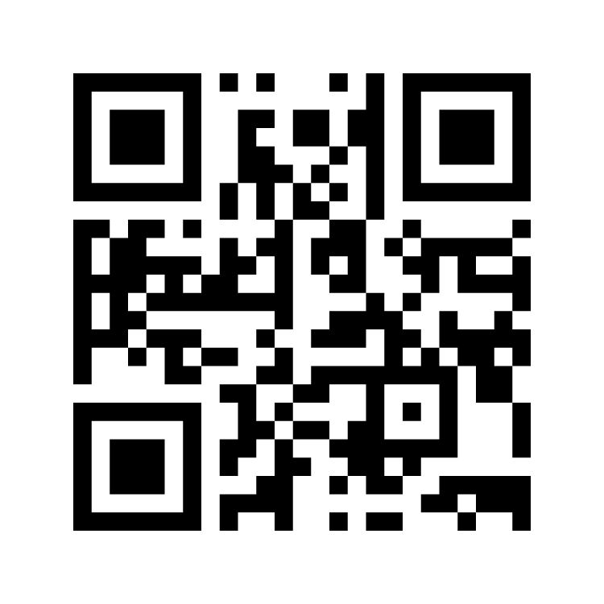
Are we covering the Expanded Core Curriculum?
Compensatory or functional academic skills
Orientation and Mobility
Social Interaction Skills
Independent Living Skills
Recreation and Leisure Skills
Career Education
Use of Assistive Technology
Sensory Efficiency Skills
Self-Determination
www.menti.com
9212 3024
Notes:
Poll and Discuss

Slide 18
Is the ECC being addressed? Study conducted by the Florida State University (over 400 teachers)
ECC areas addressed by MORE than 80% of TVIs:
Compensatory Access Skills
Self-Determination
Sensory Efficiency
Assistive Technology
ECC areas addressed by FEWER than 80% of TVIs:
Social Interaction
Career Education
Independent Living Skills
Recreation and Leisure
Orientation and Mobility

Slide 19
Where do we start? or Can you show me your FVLM(t)A[ECC]?
Functional Vision Assessment
Learning Media Assessment [(including Academic present levels (at least an Informal Reading Inventory)]
Technology Assessment (including Digital Literacy)
Orientation and Mobility Assessment
Expanded Core Curriculum Assessment
Notes:
This should not ignore the value of other professionals and assessors and the information that they can gather regarding student’s present levels (OT, SLP, PT, Transition specialists, etc.)

Slide 20

How are you currently handling TVI/O&M Assessments?

Slide 21
Functional Vision
California Education Code 56352
(a) A functional vision assessment conducted pursuant to Section 56320 shall be used as one criterion in determining the appropriate reading medium or media for the pupil.
The Functional Vision Assessment/Evaluation should evaluate the students use of vision in their natural environment (home, school, and community), with consideration to lighting, and extensive support needs including biobehavioral considerations.

Slide 22
Functional Vision Assessment/Evaluation
Collect the eye doctor report to plan for the assessment!
Determine if a low vision clinic appointment can be beneficial.
A few examples of tools
Essential Tools of the Trade, TSBVI
APH Assessment of Functional Vision
NewT, APH
Essential Assessments Rubric for Children who are Blind or Visually Impaired (not an assessment but a tool to guide assessment and instruction)
The CVI Range (assessment within Cortical Visual Impairment, 2nd Edition)
Notes:
Remember that the ophthalmology report is not essential for determining eligibility, but it will be essential in determining next steps

Slide 23
Learning Media
California Education Code 56352
(b) An assessment of braille skills shall be required for functionally blind pupils who have the ability to read…A local educational agency may provide pupils with low vision with the opportunity to receive assessments to determine the appropriate reading medium or media
The Learning Media Assessment should determine the range of media (braille/tactile, auditory, print) that students need to best facilitate access to learning at school, home, and in the community with consideration to findings regarding functional vision, reading efficiency, and be inclusive of technology all with respect to any extensive support needs including biobehavioral consideration.

Slide 24
Learning Media Assessment
Identify use of sensory channels
Identify reading efficiencies.
Specify learning mediums.
A few examples of tools
Essential Tools of the Trade, TSBVI
NewT, APH, APH Assessment of Functional Vision
Individualized Systematic Assessment of Visual Efficiency (ISAVE) Kit (additional disabilities)
Looking to Learn, AFB Press
Learning Media Profile
Essential Assessments Rubric for Children who are Blind or Visually Impaired (not an assessment but a tool to guide assessment and instruction)
The CVI Learning Media Profile (within Sensory Balance: An Approach to Learning Media Planning for Students with CVI)

Slide 25
Technology
Cal. Code Regs. Tit. 5, § 3051.19 - Assistive Technology Service
IDEA Section §1401. Definitions
The term “assistive technology device” means any item, piece of equipment, or product system, whether acquired commercially off the shelf, modified, or customized, that is used to increase, maintain, or improve functional capabilities of a child with a disability.
The term “assistive technology service” means any service that directly assists a child with a disability in the selection, acquisition, or use of an assistive technology device.
The Technology Assessment should determine the appropriate technology and assistive technology for a student to facilitate access to learning at school, home, and in the community with consideration to findings regarding function vision, learning mediums, and extensive support needs.

Slide 26
Technology Assessment
Identify appropriate hardware and software to meet a students access to technology.
Identify next steps to facilitate skill acquisition.
A few examples of tools
Access Technology Evaluation Checklist for Blind and Low Vision Needs
(from Access Technology for Blind and Low Vision Accessibility)
Maryland Instructional Technology Skills Inventory (Screen reader, magnifier, and iPad grade level targets)
Georgia Project Assistive Technology Assessment
CSB Observation and Consultation Templates
Wisconsin Assistive Technology Initiative (WATI)
SETT Framework (four components: Student, Environment, Task, and Tool)
Quality Indicators for Assistive Technology Services (QIAT)
Advancing Learning in Differentiation and Inclusion (ALDI) (focus on AT decisions related to Universal Design and RtI)
Education Tech Points
TPACK Framework (Technological, Pedagogical, and Content Knowledge)

Slide 27
Orientation and Mobility
California Education Code 56354
(a) (1) If an orientation and mobility evaluation is determined to be needed for a pupil who is blind, has low vision, or is visually impaired, it shall be conducted by a person who is appropriately certified as an orientation and mobility specialist.
(2) …shall occur in familiar and unfamiliar environments, in varying lighting conditions, and in the home, school, and community, as appropriate.
(2) If a local educational agency prohibits an orientation and mobility specialist from using their vehicles for the transportation of pupils to and from orientation and mobility instruction, the local educational agency shall provide, without cost to the orientation and mobility specialist, an equally effective transportation alternative for that purpose.

Slide 28
O&M Assessment
Identify present and future travel needs, currently known concepts, current travel abilities, use of functional vision in travel environments.
A few examples of tools
Teaching Age-Appropriate Purposeful Skills: An Orientation & Mobility Curriculum for Students with Visual Impairments (TAPS), TSBVI
NMSBVI Orientation & Mobility Inventory
Notes:
I am not a COMS; I respect there are many details left out here.

Slide 29
Expanded Core Curriculum Assessment
Screen all areas of the ECC and prioritize areas for more in-depth assessment.
Establish instructional priorities for the next three years and revisit every year.
A few examples of tools
Essential Tools of the Trade, TSBVI
Utah School for the Blind ECC– High School Readiness Checklist (Pre-K-8th)
Material Request Link
Evaluating Visually Impaired Students (EVALS), TSBVI
Transition Tennessee (Assessment and additional resources)
Student Annual Needs Determination Inventory (SANDI)
Essential Assessments Rubric for Children who are Blind or Visually Impaired
Perkins Activity and Resource Guide Downloadable Materials
Expanded Core Curriculum (ECC) Resources Live Binders
Resources for the Expanded Core Curriculum (RECC), TSBVI (ECC resource finder)

Slide 30
Expanded Core Curriculum Assessment
Early Years and Developmental ages 0-6
The Oregon Project (birth to 6)
Insite Developmental Checklist (birth to 5)
Functional Skills Assessment, Lilli Nielson (birth to 4 developmental age)
Hawaii Early Learning Profile (0-3 and 3-6)
BRIGANCE Inventory of Early Development (IED) III (0-1st grade)

Slide 31
Comprehensive Vision Report FVLM(t)A [ECC]
Describes student’s learning needs
Identifies curricular priorities
Describes how assistive technology supports access to education and learning media
Supports recommendations to the IEP team
Justifies services!

Slide 32
Comprehensive Vision Report Share
The California School for the Blind put together a template for a Comprehensive Vision Assessment inclusive of functional vision, learning media, technology, and the expanded core curriculum. Due to the nature of a state special school, there are elements of academic readiness built-in to the learning media assessment that may need to be altered or co-assessed in an itinerant service provider model.
Comprehensive Vision Assessment: FVLM(t)A [ECC]
Comprehensive Vision Assessment Companion Document
Notes:
A comprehensive vision report:
Describes student’s learning needs
Identifies curricular priorities
Describes how assistive technology supports access to education and learning media
Supports recommendations to the IEP team
Justifies services!

Slide 33
One of the guidelines of I.D.E.A. states that Educational assessment cannot be based on the results of a single test.
So go ahead and shove them all together!

Slide 34
All that?
Being a TSVI and/or O&M is hard work.

Slide 35
B/LV students are a diverse population
Blind or low vision
Deafblind
Physical disabilities
Extensive support needs
Neurological disabilities (auditory processing / Learning Disabilities)
Emotional/behavior disabilities
Autism Spectrum Disorders
Reading, writing, math (mild/moderate disabilities and resource)
Traumatic brain injury
Cerebral visual impairment
Convergence Insufficiency
Notes:
How do we make the curriculum meaningful for all students?

Slide 36
How do you make activities meaningful?
discussion

Slide 37
The ‘ECC is in everything’ - cue eye roll
Classic lesson/lecture in our graduate programs is to watch a video and identify what parts of the ECC are at play in the lesson.
The point behind the point is to BE INTENTIONAL.
Notes:
Eventually all elements of the ECC were called out; the intentionality and systematic instruction is what makes activities meaningful.

Slide 38
Share strategies and activities that have worked effectively to incorporate the ECC
discussion

Slide 39
Being intentional requires knowing what areas to address and identifying what is meaningful and valuable for the student.
Notes:
In order to engage students in active learning our goal should be to increase enjoyment and desire; thus, keeping the student motivated to participate and initiate.

Slide 40
First Steps in Assessments: Identifying Learning Preferences
How does a student learn best?
Bio behavioral status
Attention span & distractibility
Environmental clutter: Auditory, Visual, Tactile
Tactile defensiveness versus tactile exploration
Concrete versus abstract concepts
Motivation
Generalization of skills: Is the activity meaningful?
Notes:
Bio behavioral:
When during the school day do they learn best?
Medications?
Sleepiness?
Observation:
- Remember to observe your student in various environments and choose activities that are motivating.
Generalization:
How can we take the skills in the instructional environment and make them applicable to the
Repeated goals:
- If you find yourself rolling over goals year after year, then you need to reassess and discover what is motivating

Slide 41
Determining Instructional Priorities in the ECC
Worksheet from Essential Tools of the Trade can be used to ensure that all nine areas of the Expanded Core Curriculum are being addressed in a systematic manner.
Determining Instructional Priorities for the Expanded Core Curriculum Data Collection Worksheet
Further information and detail can be found in Essential Tools of the Trade
Notes:
Data collection is so important and there are tools to gather data within Essential Tools of the Trade

Slide 42
The Utah School for the Blind ECC High School Readiness Checklists
Expanded Core Curriculum High School Readiness Checklist Tutorial
ECC HS Readiness Checklist Tutorial Handout
Teacher Requested Checklists
Gather all of the tools and information regarding the Utah School for the Blind ECC– High School Readiness Checklist (Pre-K-8th) by filling out the Material Request Link.

Slide 43
What challenges do you face trying to implement the ECC?
discussion
Notes:
What are your barriers?

Slide 44
Ideas
Focus on meaningful independent living skills; build into everyday routines
Lunch lessons with and without peers (funding)
Signature practice daily (on every assignment?)
Combine ECC goals with other service providers (collaboration)
Continue the brainstorm in discussion…
Notes:
Collaboration on goals causes students to cross environments and providers to cement skills faster

Slide 45
Convincing support at home
Videos and pictures provide evidence and acceptance to parents of their children’s capabilities and demonstrate the worth of the journey on the way to the completed task!
Engage parents in partnership even if just so they cananswer the question:
“Can I….?”
with
“I don’t know, why don’t you try.”
Notes:
The messes created while preparing food is well worth the result of a student feeding themselves but are so hard for parents to accept in the moment.

Slide 46
Partnership with the California School for the Blind
Short-Term Programs
Day Camps
Targeted lessons
After-School Sports
Low Vision Clinic
Assistive Technology Lab
Assessment
Enrollment
Discover more information and contacts at our website www.csb-cde.ca.gov

Slide 47
Circling back to progress with the law
AB-947 Visually impaired pupils: expanded core curriculum (“The O&M Bill”)
O&M evaluations shall be conducted by certified specialist, occur in unfamiliar environments, varying lighting, in the home, school, and community, and provide transportation.
School districts may consider the ECC for IEPs for BVI students and those services may be provided before or after school hours.
ECC Mandate Draft Legislation
Would require TVI/O&M to assess in all areas of the ECC and provide LEA compensation for additional workload.
The Cogswell-Macy Act
Would ensure specialized instruction, increase services and resources, enhance accountability, and increase research into best practices.

Slide 48
Where can we go from here?
Are there areas of the ECC that you or your agency is excelling at assessing and teaching?
What improvements can your agency put into effect to assess and implement instruction in the ECC?
Review and utilize the resources included in this presentation.
Connect with specialists at the California School for the Blind to move your program forward!

Slide 49


Thank you
Adrian Amandi
Director of the Education Resource Center California School for the Blind
aamandi@csb-cde.ca.gov

Slide 50
Primary Resources
Expanded Core Curriculum (ECC): An Educational and Legal Requirement
Essential Tools of the Trade: A “How To” Guide for Completing Functional Vision, Learning Media, and ECC Evaluations
Keys to Educational Success: Teaching Students with Visual Impairments and Multiple Disabilities
Expanding the Expanded Core Curriculum for Students with Visual Impairments & Multiple Disabilities
ECC Essentials: Teaching the Expanded Core Curriculum to Students with Visual Impairments

Slide 51
Legal Citations
IDEA: Individuals with Disabilities Education Act
20 U.S. Code § 1401 - Definitions
34 CFR § 300.320 - Definition of individualized education program
CDE: LCFF Priorities/Whole Child Resource Map
CDE: Multi-Tiered System of Supports
Cal. Code Regs. Tit. 5, § 3030 - Eligibility Criteria
CA Education Code for IEP for Visually Impaired Pupils (56350-56354)
Cal. Code Regs. Tit. 5, § 3051.7 - Vision Services

Slide 52
References throughout the presentation
The National Agenda for the Education of Children and Youths with Visual Impairments, Including Those with Multiple Disabilities
A Bill of Rights for All Children with Visual Impairment and their Families
Guidelines for Programs Serving Students With Visual Impairments - 2014 Revised Edition
Local Control Funding Formula (LCFF)
California’s Multi-Tiered System of Supports
Office of Special Education Programs (OSEP) Results Driving Accountability (RDA)
Comprehensive Vision Assessment: FVLM(t)A [ECC]
Comprehensive Vision Assessment Companion Document
Determining Instructional Priorities for the Expanded Core Curriculum Data Collection Worksheet
ECC High School Readiness - Teacher Requested Checklists
Expanded Core Curriculum High School Readiness Checklist Tutorial
ECC HS Readiness Checklist Tutorial Handout

Slide 53
Assessment Resources Referenced
(FVA/LMA) Essential Tools of the Trade, TSBVI
(FVA/LMA) NewT, APH and APH Assessment of Functional Vision
(FVA/LMA) Essential Assessments Rubric for Children who are Blind or Visually Impaired
(FVA) The CVI Range (Cortical Visual Impairment, 2nd Edition)
(LMA) Individualized Systematic Assessment of Visual Efficiency (ISAVE) Kit (additional disabilities)
(LMA) Looking to Learn, AFB Press
(LMA) Learning Media Profile
(LMA) The CVI Learning Media Profile (within Sensory Balance: An Approach to Learning Media Planning for Students with CVI)
(O&M) Teaching Age-Appropriate Purposeful Skills: An Orientation & Mobility Curriculum for Students with Visual Impairments (TAPS), TSBVI
(O&M) NMSBVI Orientation & Mobility Inventory

Slide 54
Assessment Resources Referenced cont. (AT)
(Tech) Access Technology Evaluation Checklist for Blind and Low Vision Needs
(from Access Technology for Blind and Low Vision Accessibility)
(Tech) Maryland Instructional Technology Skills Inventory (Screen reader, magnifier, and iPad grade level targets)
(Tech) Georgia Project Assistive Technology Assessment
(Tech) CSB Observation and Consultation Templates
(Tech) Wisconsin Assistive Technology Initiative (WATI)
(Tech) SETT Framework (four components: Student, Environment, Task, and Tool)
(Tech) Quality Indicators for Assistive Technology Services (QIAT)
(Tech) Advancing Learning in Differentiation and Inclusion (ALDI) (focus on AT decisions related to Universal Design and RtI)
(Tech) Education Tech Points
(Tech) TPACK Framework (Technological, Pedagogical, and Content Knowledge)

Slide 55
Assessment Resources Referenced cont. (ECC)
(ECC) Essential Tools of the Trade, TSBVI
(ECC) Utah School for the Blind ECC– H.S. Readiness Checklist (Pre-K-8th) Material Request Link
(ECC) Evaluating Visually Impaired Students (EVALS), TSBVI
(ECC) Transition Tennessee (Assessment and additional resources)
(ECC) Student Annual Needs Determination Inventory (SANDI)
(ECC) Essential Assessments Rubric for Children who are Blind or Visually Impaired
(ECC) Perkins Activity and Resource Guide Downloadable Materials
(ECC) Expanded Core Curriculum (ECC) Resources Live Binders
(ECC) Resources for the Expanded Core Curriculum (RECC), TSBVI (ECC resource finder
(ECC) The Oregon Project (birth to 6)
(ECC) Insite Developmental Checklist (birth to 5)
(ECC) Functional Skills Assessment, Lilli Nielson (birth to 4 developmental age)
(ECC) Hawaii Early Learning Profile (0-3 and 3-6)
(ECC) BRIGANCE Inventory of Early Development (IED) III (0-1st grade)

Slide 56
Alluded to Resources
What is the Expanded Core Curriculum for Blind and Visually Impaired Students?
Understanding the Expanded Core Curriculum
Workload Analysis Presentation
Journey of AB-947 in California
Towards an ECC Mandate in California
The Alice Cogswell and Anne Sullivan Macy Act: An Even Better IDEA
Access Technology for Blind and Low Vision Accessibility
The Independent Little Bee blog

